Slide 1

Texas Traffic 2013
Insights from 2013 data on traffic accidents in Texas.
Focus on days and times of highest incidence.

Slide 2

Car Accidents in Texas (2013)
There were 108,705,304 total car accidents recorded in 2013 for the State of Texas.

Slide 3
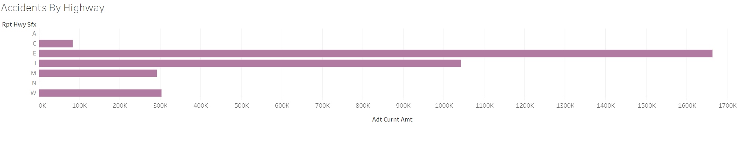
Number of Accidents by Highway
The Highway with the highest number of accidents was Highway E with 1,663,893 accidents in 2013.

Slide 4
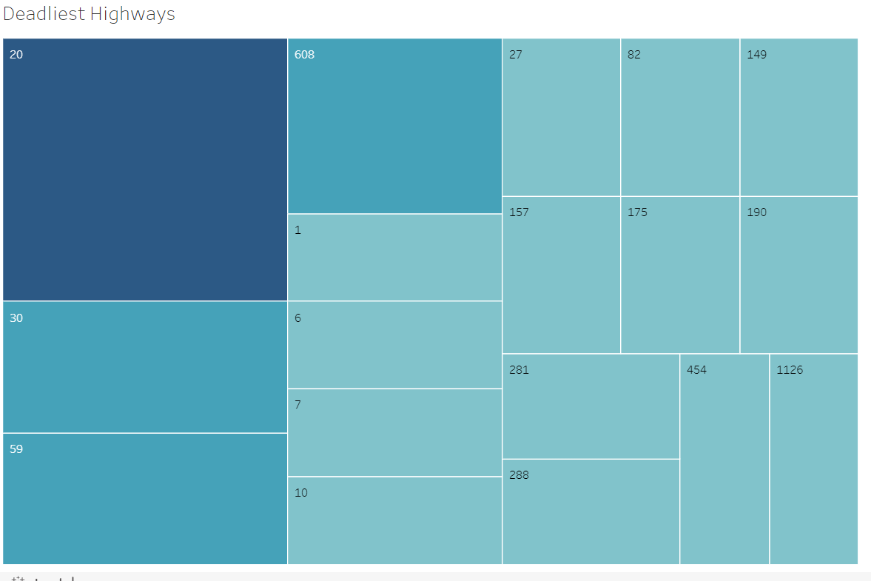
Car Accident Deaths by Highway
24 deaths occurred on Texas Highways in 2013.
4 deaths occurred on Highway 20
2 deaths occurred on Highways 608, 30 and 59
1 death occurred on each other Highways pictured

Slide 5
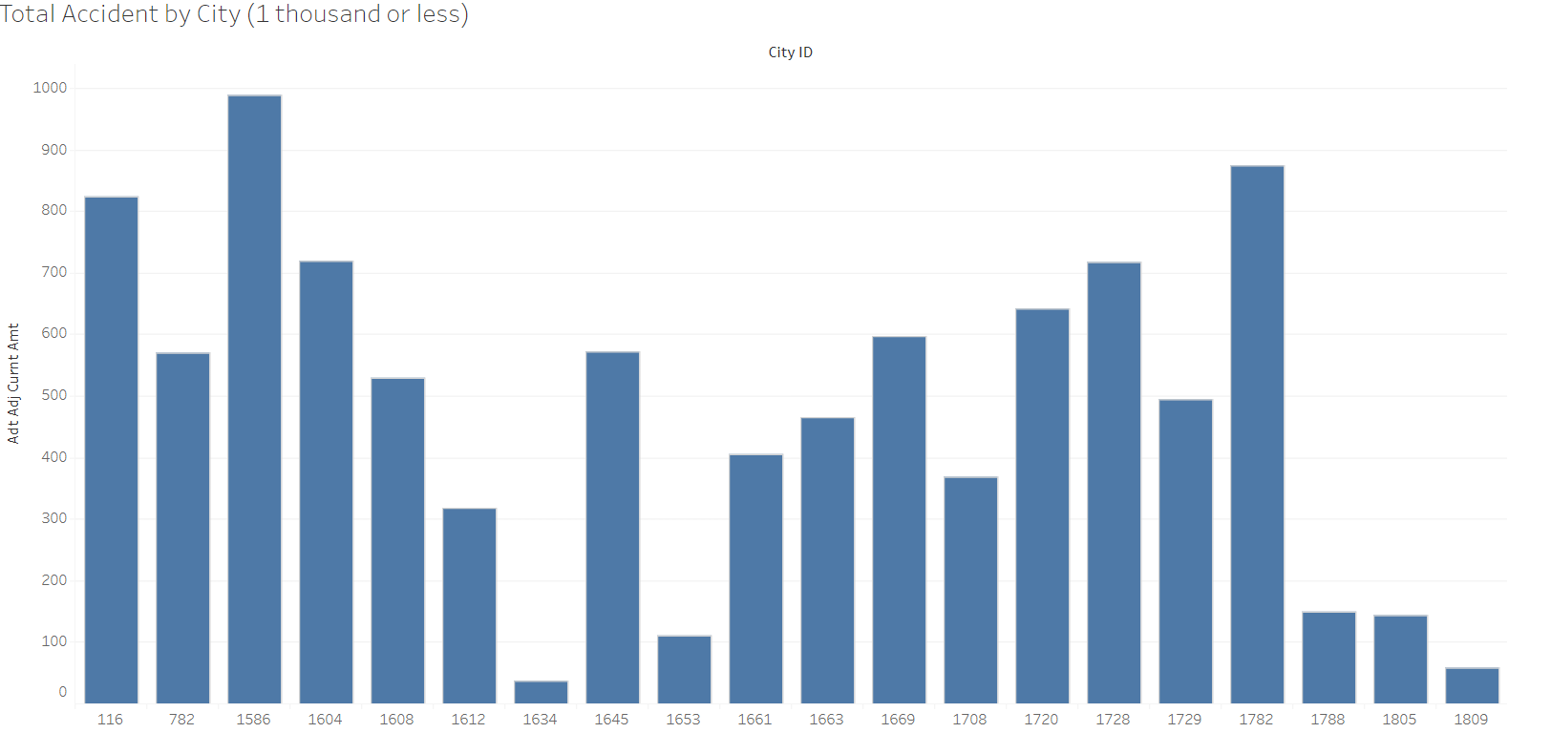
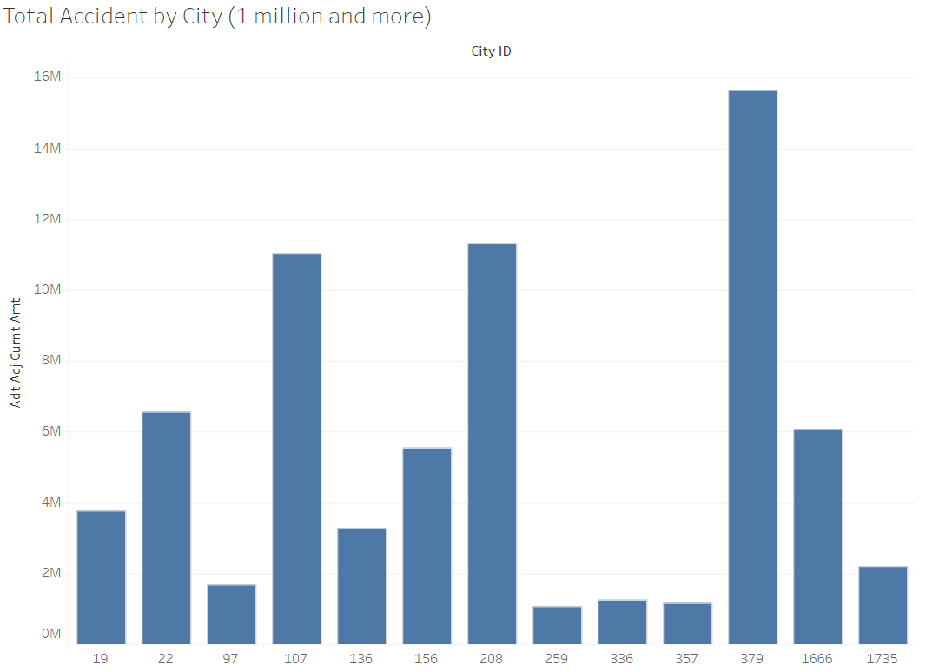
Accidents by City
Cities with 1 thousand accidents or less
City number 1634 had the least number of accidents with 36.
Cities with 1 million accidents or more
City number 379 had the most accidents with 15,658,952

Slide 6
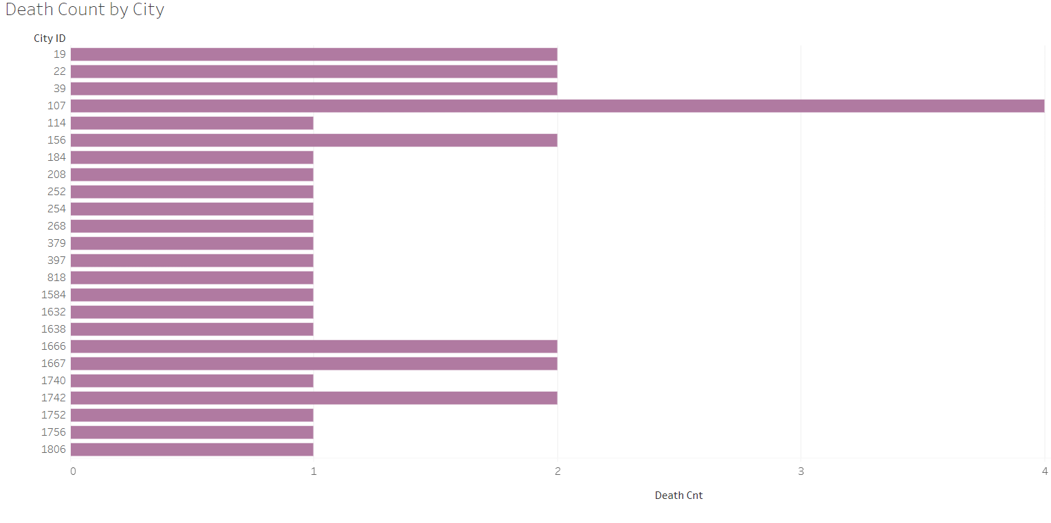
Number of Car Accident Deaths by City
City number 107 had the most deaths at 4.

Slide 7
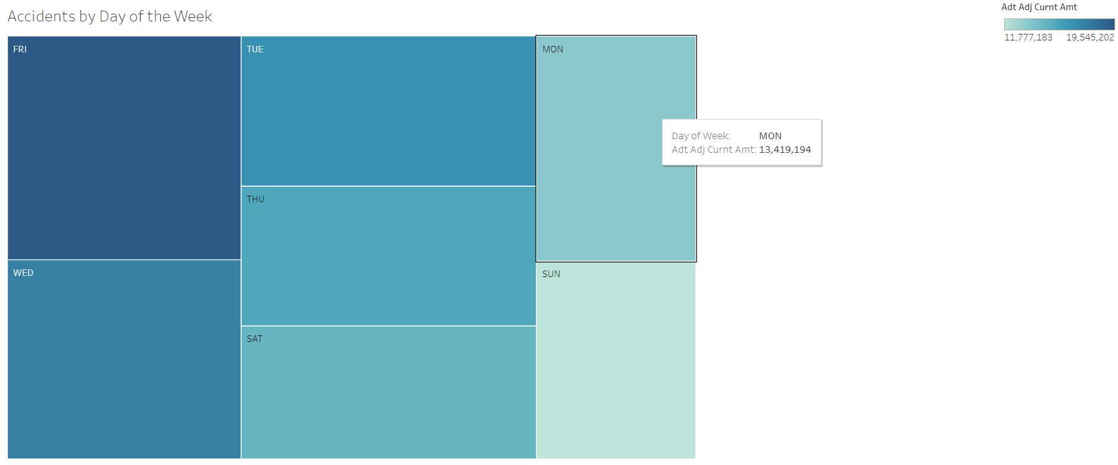
Car Accidents by Day of the Week Graph 1

Slide 8
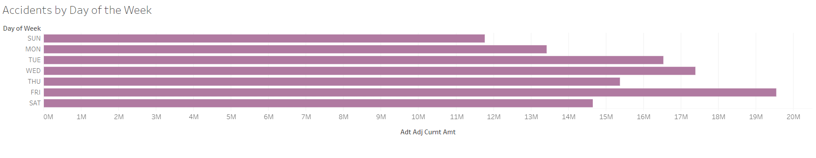
Car Accidents by Day of the Week Graph 2
Rankings of the Days of the Week by Accidents (highest to lowest)
1. Friday
2.Wednesday
3.Tuesday
4.Thursday
5.Saturday
6.Monday
7.Sunday

Slide 9
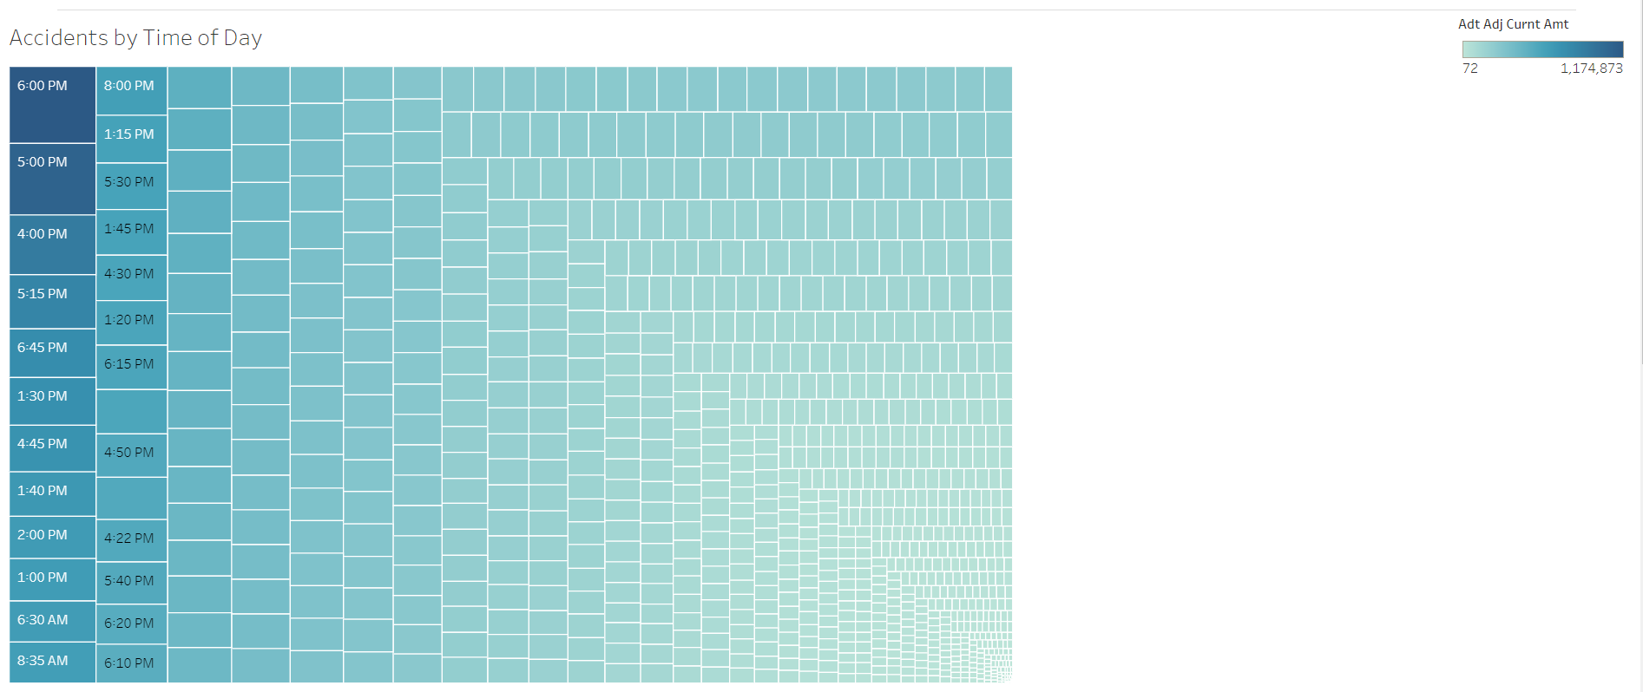
Accidents by Time of Day

Slide 10
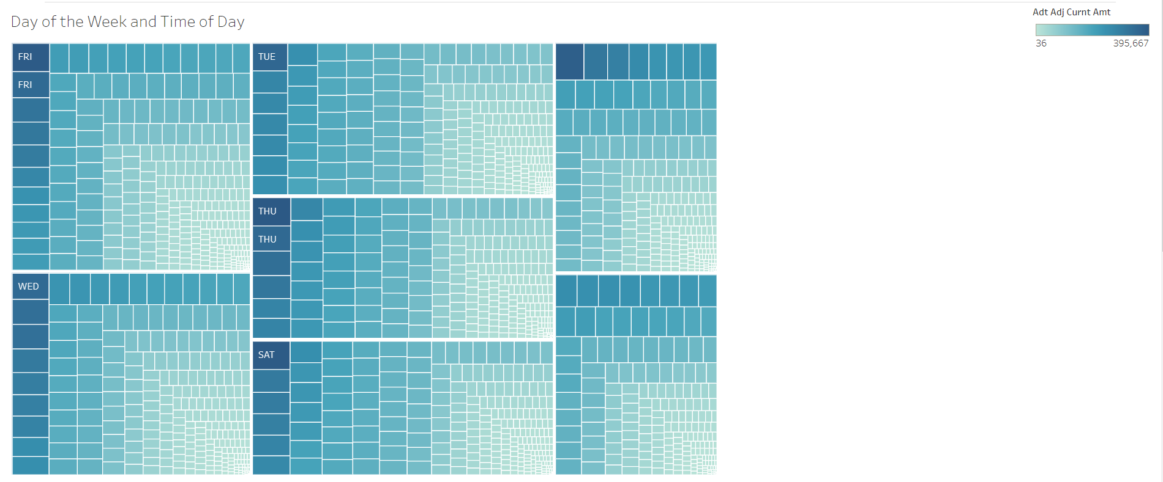
Accidents by Day and Time

Slide 11
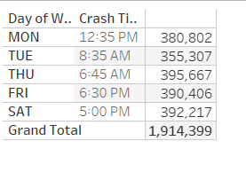
Insights into Day and Time
Top 5 most dangerous traffic times
17% of all accidents for 2013 occurred between 5-7pm
18% of all accidents for 2013 occurred on a FRIDAY which is the highest incident day
12% of accidents occur on MONDAY which is the lowest incidence day.
Top
These five times account for 2% of the total accidents for 2013.

